Slide 1
Top 10 Product Sales Dashboard
File created on: 6/17/2022 10:28:09 PM

Slide 2
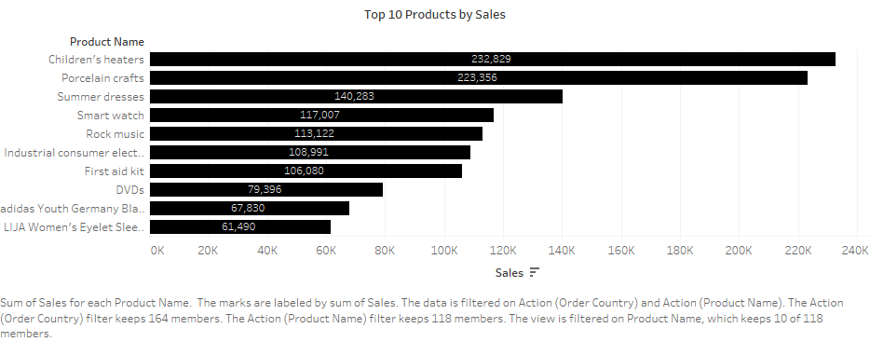

Slide 3
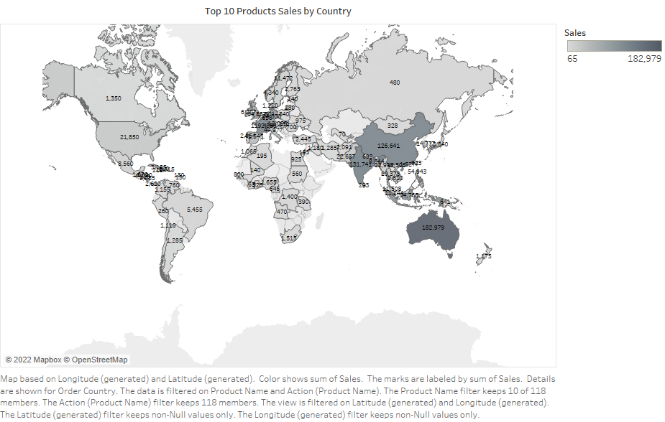

Slide 4
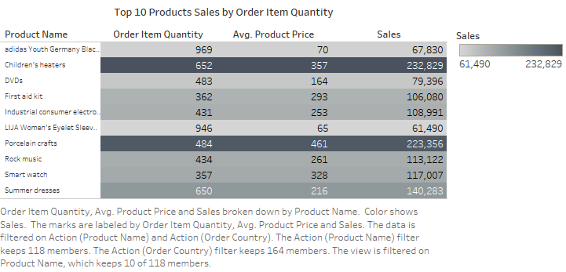

Slide 5
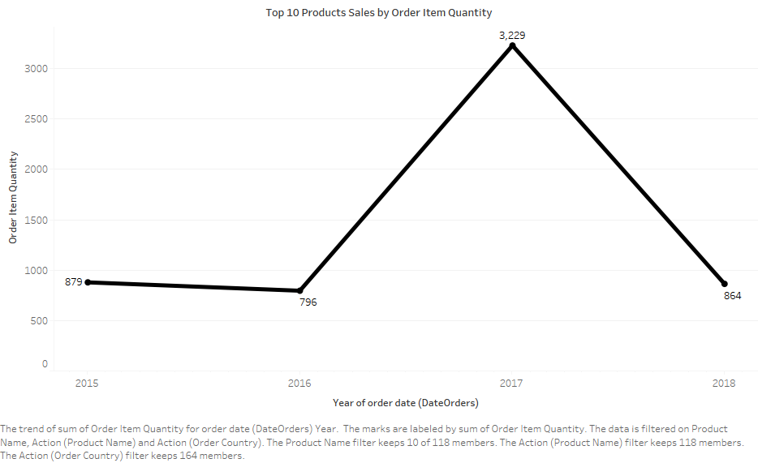

Slide 6
